Slide 1

AI Based Soar
Group No. 12
Rahul Vast : 17104042
Shruti Sawant : 18204001
Aishwarya Thorbole : 18204002
Project Guide : Prof. Vishal Badgujar

Slide 2
Contents
Introduction
Objectives
Problem Definition
Technological Stack
Review Suggestions
Proposed System Architecture/Working
Prototype Design Demonstration
Plan of Paper Publication

Slide 3
Introduction
Soar stands for Security Orchestration, Automation and Response
Our project AI Based Soar, main purpose is to gather security related data in real time, perform analysis of that data and make a decision based on that data.
The components of our system will be SIEM, Automated STIX Engine, Translated Multilingual Threat Data, Threat Repository and Honeypot.
The Security orchestration part is performed by the components of our system.
The Automation part is performed using various opensource tools like ELK, Spiderfoot, etc.
The Response part is handled by our AI’s decision making skills using Neural Network.

Slide 4
Objectives
To translate a multilingual threat intelligence.
To recognize different patterns from the event logs/dataset, detection of the vulnerabilities in the system and patch them .
The data collected from different sources will be converted into a standardized format based via Automated STIX Engine for Privacy Preservation.
Event profiling of the data is to be done , so there would an ease to find the intelligence of previously known attack.
To efficiently differentiate between false positive and true positive types of alerts.
To identify almost all form of attacks and respond to types of attacks like Malware Attacks, SQL Injection, MITM, Password Attacks and DDOS.

Slide 5
Problem Definition
Traditional Methods for Threat Detection have the inability to gather appropriate/relevant data to be analysed for true positives. Also these methods lack quick response mechanisms for preventing modern attacks.
IDS may not be potentially always correct, it may include much more false positives. Here a new threat intelligence technique evaluated by analysing honeypot data to identify attackers behaviour to find attack patterns.
The multilingual nature of the Internet increases complications in the cybersecurity community’s ongoing efforts to strategically mine threat intelligence , from sources such as social media blogs and dark web vulnerability markets that exists in the diverse languages that security analysts often hinder about.

Slide 6
Technology Stack
Python for programming the business logic
Autokeras for utilising automl capabilities
Tensorflow for developing AI agent
Pandas for data pre-processing
AWS for computational power, storage and deployment
ELK Stack for data visuslizations and analysis
Red hat Ansible for automating configurations
Docker for creating container and ease deployment
Spiderfoot for automated OSINT gathering
p0f for passive TCP/IP stack fingerprinting
Suricata for Network Security Monitoring Engine
Nginx for reverse proxy

Slide 7
Cyberchef for encryption, decryption, encoding, etc.
Cockpit for server administration
Tpotce for honeypot
OWASP Tools for activities like vulnerability assessment, application security, testing, etc
Fatt for network meta data extraction
Cisco Packet Tracer

Slide 8
Review Suggestions
Be specific with the objectives.
Highlight the multilingual threat intelligence in objectives.
Represent the siem diagram using Dia tool.
Include the types of attacks after the objectives.
Mention the tools and techniques in proposed system.

Slide 9
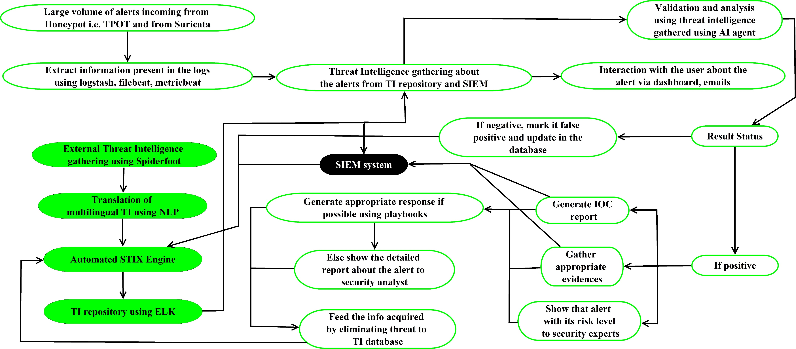
Proposed System Architecture/Working

Slide 10
Large volume of alerts will be incoming from two sources that are honeypot and internet.
This alerts will be processed using Logstash, Metric Beat, File Beat, etc like components which are part of ELK stack.
The more Threat Intelligence about the threat will be gathered from Threat Intelligence Repository.
The Threat Intelligence Repository is powered by Spiderfoot, STIX Engine and Multilingual Threat Intelligence Translation.
SIEM system will also perform the Real Time Analysis of Threat and automation of the event management using Kibana.
Decisions on how to respond will be taken by Neural Network.
Based on the same reports will be generated and populated to the user.

Slide 11
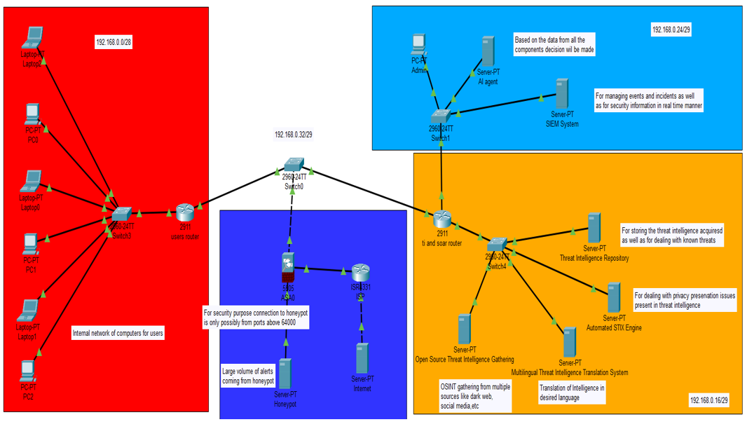
Prototype Design Demonstration

Slide 12
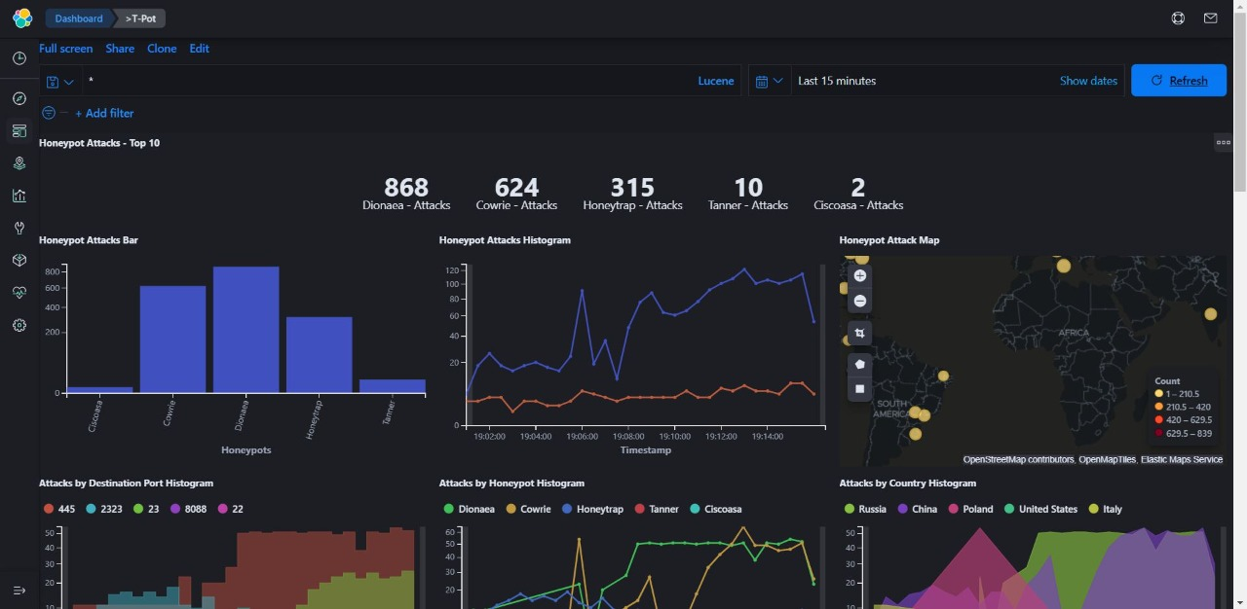
Tpot Mult-Honeypot Dashboard

Slide 13
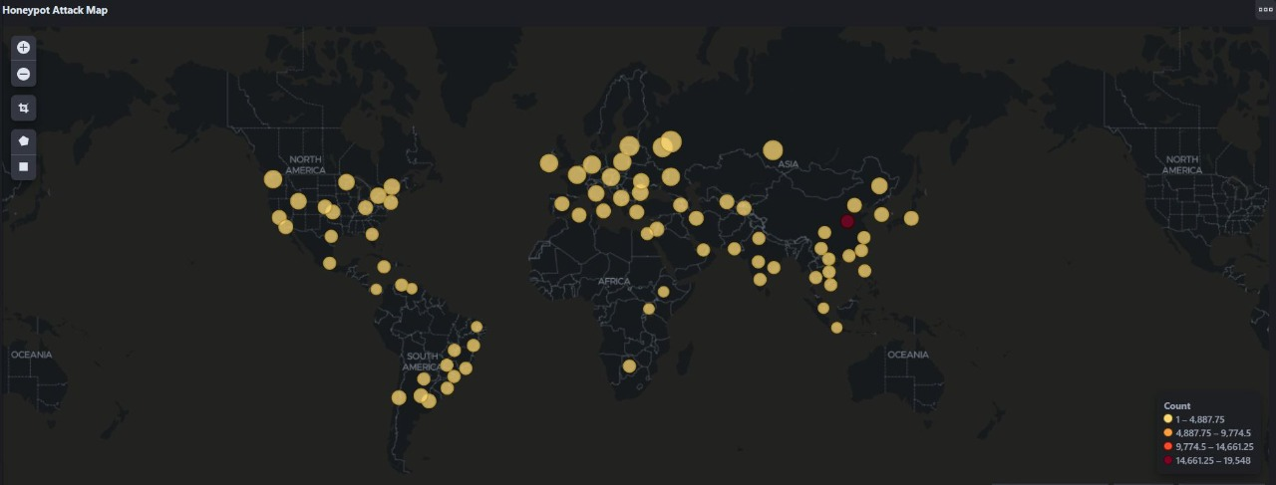
Honeypot Attack Map

Slide 14
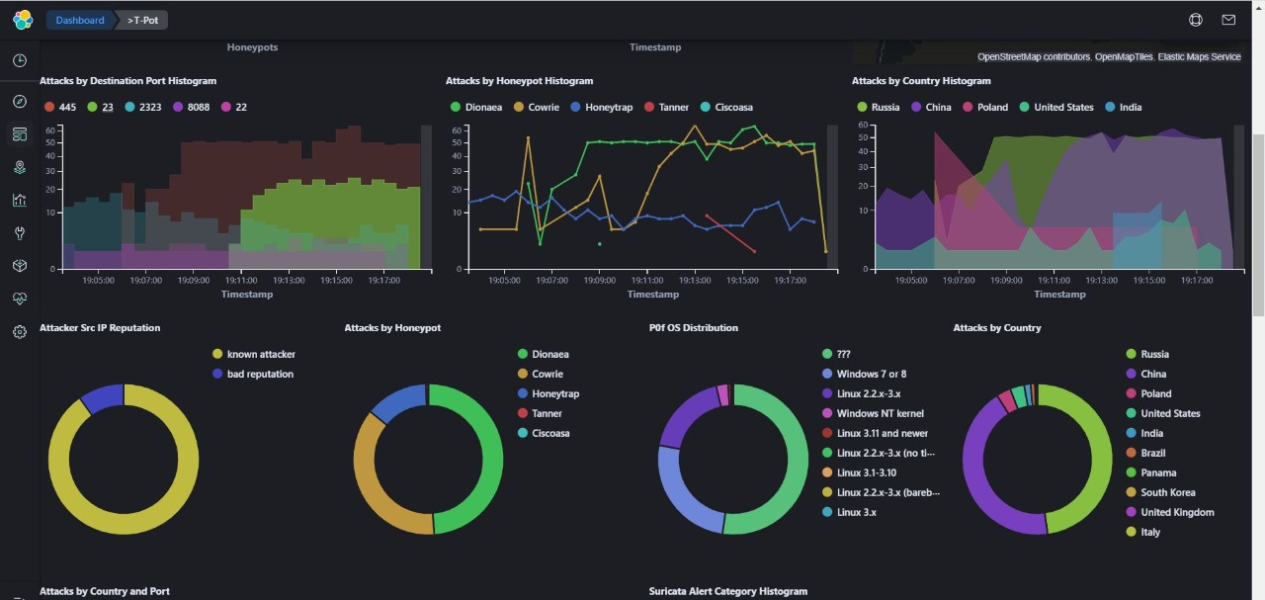
Attacks Distribution

Slide 15
Plan of Paper Publication
Artificial Intelligence based Security Orchestration, Automation and Response System accepted in “2021 6th International Conference for Converegence in Technology”.

